Slide 1

RELATIONSHIPS
Principles of Human Services

Slide 2
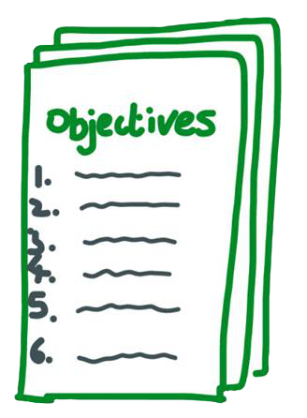
Objectives
§130.242. Principles of Human Services
(3) The student demonstrates the skills necessary to enhance personal and career effectiveness in counseling and mental health services. The student is expected to:
(E) identify the contributing factors and describe the impact of stress on individuals and relationships;
(F) investigate causes, prevention, and treatment of domestic and relationship violence;

Slide 3

Types of Relationships
Friend
Romantic
Community
Family
Professional

Slide 4

Characteristics of HEALTHY Relationships
Equality
Physical Safety
Comfort
Independence
Honesty
Respect
Sexual Respect
Humor

Slide 5
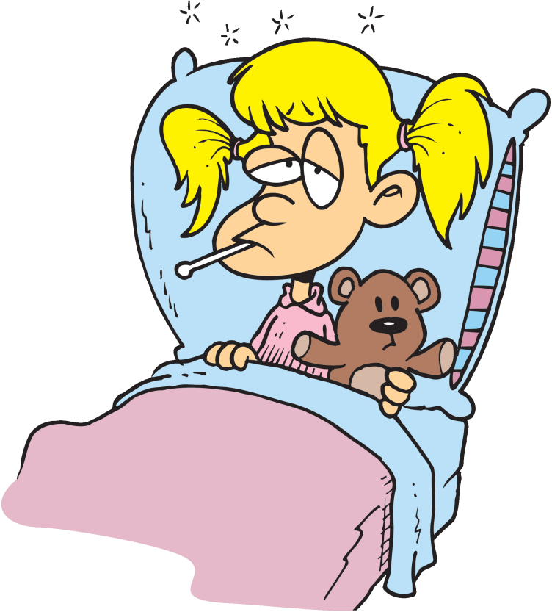
Characteristics of UNHEALTHY Relationships
Control
Physical abuse
Intimidation
Dependence
Dishonesty
Disrespect
Sexual abuse
Hostility

Slide 6
STRESS
STRESS
STRESS
STRESS
STRESS
STRESS
STRESS
How does stress impact healthy and unhealthy relationships?

Slide 7

STRESS and Healthy Relationships
Stress is inevitable as we all experience it
Healthy relationships experience stress, and individuals in these relationships can effectively work through periods of stress
When stress affects healthy relationships, individuals can work through these periods by supporting each other, communicating, listening, respecting, and comforting each other.

Slide 8
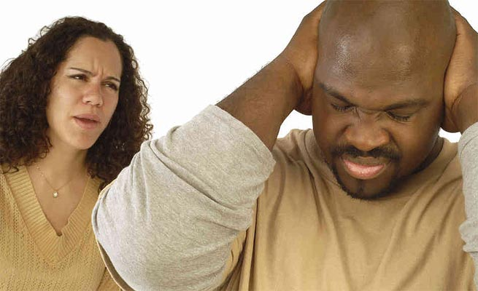
STRESS and Unhealthy Relationships
When relationships are not healthy, added stress can only contribute negatively.
Individuals in unhealthy relationships do not handle stress in the most appropriate ways.
  Physical, emotional, and sexual abuse can result if added stress is not handled appropriately.

Slide 9
Check it out!
http://safe.unc.edu/

